Slide 1
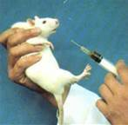

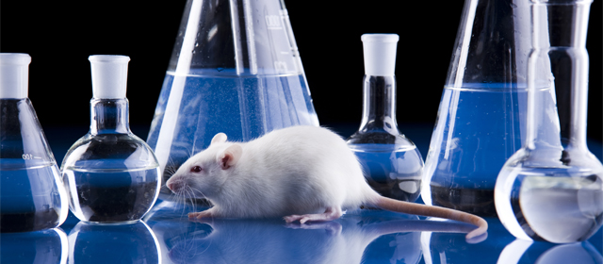
TOXICITY STUDIES

Slide 2
Before any potential new medicine can be administered to man its safety must be investigated in animals in order to define safe human doses.
Five general criteria for defining the high dose in a toxicology study:
Maximum tolerated dose
Limit dose
Top dose based on saturation of exposure
Maximum feasible/practical dose
Dose providing a 50-fold margin of exposure

Slide 3
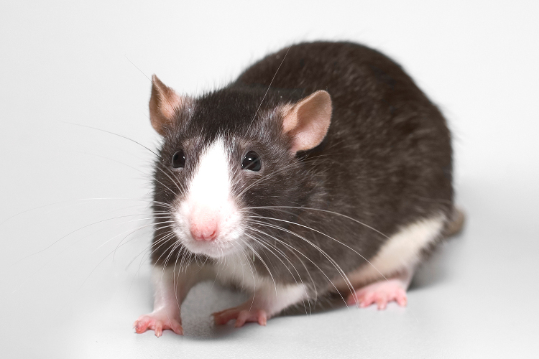
Maximum Tolerated Dose
Highest dose that will be tolerated for the study duration
A dose where target organ toxicity is likely to be observed but where the dose is not so high that the study is jeopardized by morbidity or mortality.
Limit dose
The limit dose defines the highest dose that should be used in the absence of a demonstrable MTD. The limit dose is generally accepted as 1000mg/kg in both rodents and non-rodents.

Slide 4
Toxicokinetics and saturation of exposure
Describes the systemic exposure achieved in animals and its relationship to the dose, sex, species and the time course of the toxicity study.
Blood samples are taken from animals on toxicity studies and the plasma/serum or blood concentrations of the test item or its metabolites are measured
Where toxicokinetic data indicate that absorption limits exposure to the test item or its metabolites, the lowest dose which achieves maximum exposure should be used as the high dose in the absence of other dose limiting constraints. This is often referred to as saturation of exposure.

Slide 5
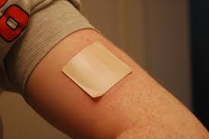
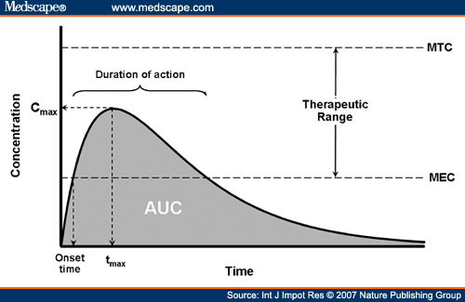
Maximum Feasible Dose
Practicalities, such as formulation, can mean the high dose is limited by what is technically feasible based upon the maximum possible concentration of the test item in the formulation.
Doses providing a 50-fold margin of exposure.
Based on the group mean of the area under the curve (AUC) values of the test item.
Generally acceptable as the maximum
dose for acute and repeated dose toxicity
studies in any species.

Slide 6
Important Terms
The Globally Harmonized System (GHS)
Maximum Tolerated Dose (MTD)
No Observable Effect Level (NOEL)
Organization for Economic Cooperation and Development (OECD)
Committee for the Purpose of Control and Supervision of Experiments on Animals (CPCSEA)
Institutional Animal Ethics Committee (IAEC)
Indian Council of Medical Reasearch(ICMR)

Slide 8


